Slide 1
EP1 Manufacturing Processes
16th Feb 2024
Overview
Introduction to the course
Review Material properties
Overview of manufacturing processes
Review link between Processes and Materials
Mr Roland Hutchins
Department of Aeronautics CAGB 207

Slide 2
Introduction
About me!

Slide 3
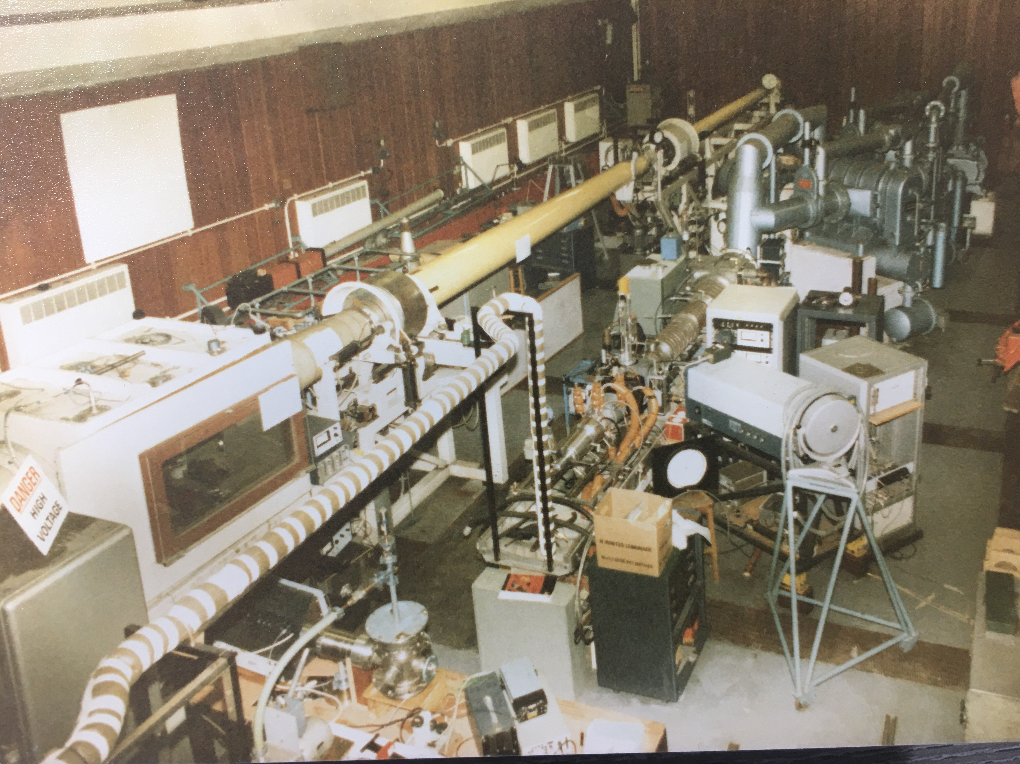

Slide 4
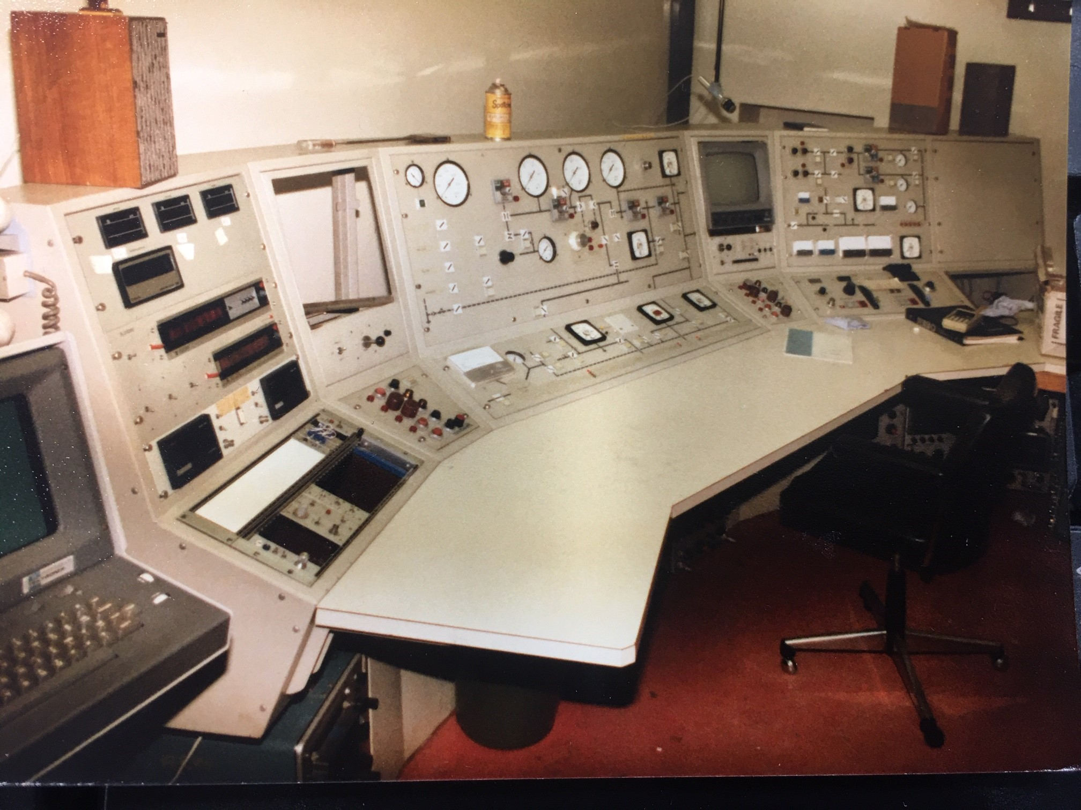

Slide 5


Slide 6

Aero Doggy Day 2019

Slide 7
Course Aims
Overview of different manufacturing processes for metals/composites
Review properties of materials
Indicate the link between process and performance
Introduce the main processes used in the manufacture of
Modern airframes
General engineering
To highlight the advantages and disadvantages of the various processes
Develop sufficient understanding of processes to enable comment on the suitability (or not) of a given process for a given application.

Slide 8
Learning Outcomes
To be aware of the mechanical properties of commonly used metal and composite systems.
To be familiar with typical applications and understand the reasons for choosing metals or composites in particular cases.
Be acquainted with the different manufacturing methods and know in which circumstances they might be used.
To enable simple trade-offs to be made at a very basic level.
To provide sufficient understanding of manufacturing processes applied to aircraft for use in the 3rd year Group Design Project.
To equip you with a basic knowledge of the many manufacturing processes.

Slide 9
Manufacturing Processes Survey!
Your experience of manufacturing processes?

Slide 10
Core Engineering Mind
Making ‘Things’ that work
And
Making ‘Things’ work better

Slide 11
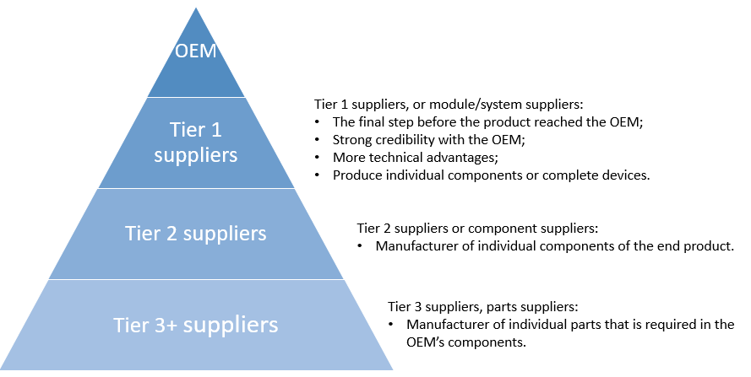
Aerospace Manufacturing
Airbus, Boeing, Bombardier, Lockheed Martin, Tupolev, BAE Systems, SAAB, Cesna
Goodrich, P&W, GE, GKN, Rolls Royce etc.

Slide 12
Tier 1 supplier capabilities
Reduce management costs.
OEM companies only need to manage tier 1 suppliers, rather than all suppliers in the supply chain. Tier 2 suppliers are usually managed by tier 1 suppliers, and so forth. In this way, there will be no middlemen in between, and the overall cost for supplier management can be well controlled.
Quality control made easier. OEM, tier 1 suppliers are the only ones they need to manage. Rigorous quality control standards by tier 1 suppliers can ensure that a disqualified part or component can be traced back to the appropriate supplier.
Faster time-to-market. - Suppliers usually have close relationships with each other, and they understand well one another’s way of operation and capabilities, which can help to reduce the time-to-market for the product.
Reduce risks. Strong credibility because of their technical expertise & capabilities,

Slide 13
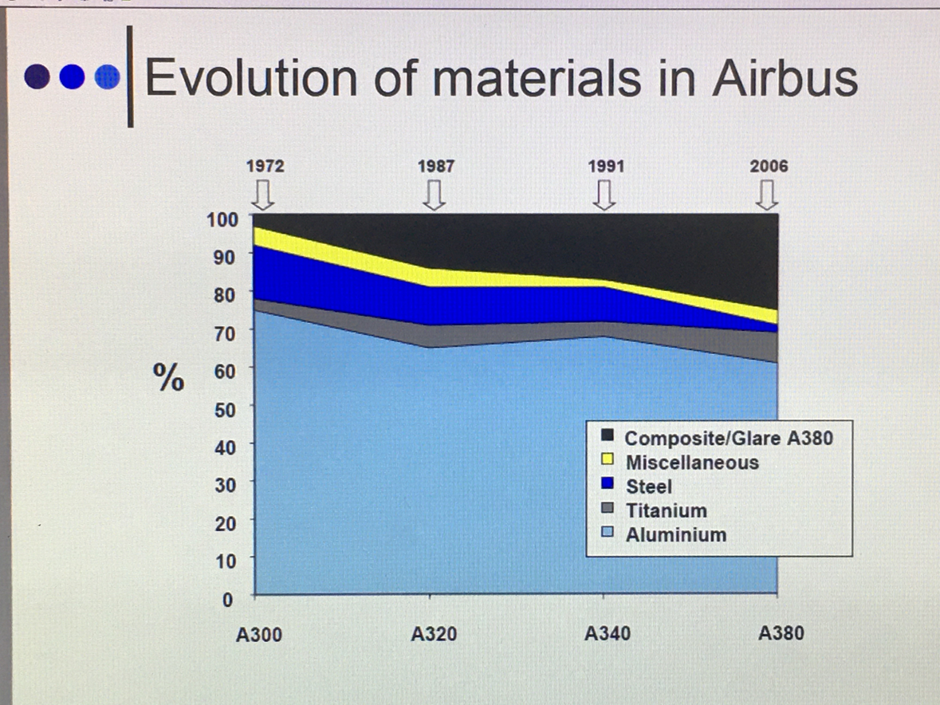

Slide 14
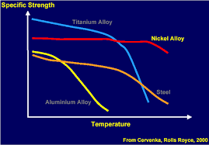
Materials used in Aero-Engines

Slide 15
Manufacturing Processes
Quiz 1
Name a manufacturing process….

Slide 16
Course Syllabus
Fabrication Processes : Sheet metals, bending, pressing, drawing, spinning, stretch-forming etc. material limitations and tolerances, plastic forming and diffusion bonding, extrusions; forging and casting methods; machining and NC machining; moulding techniques (open and closed moulds), composite materials etc.
Cutting and Joining methods : Welding, metal/Tungsten inert gas, Laser welding,
Water jet cutting, laser cutting, adhesive bonding, riveting, and surface pre-treatment.

Slide 17
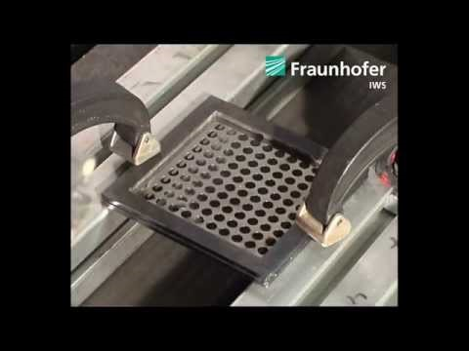

Slide 18
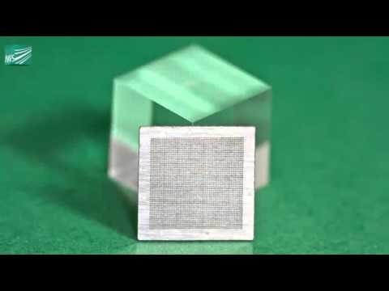

Slide 19
Manufacturing Processes
Quiz 2
Name a factor that affects the choice of manufacturing process…
Cost
Time
Material
Tolerance
Post processing/Surface finish
Volume of units required
Size

Slide 20
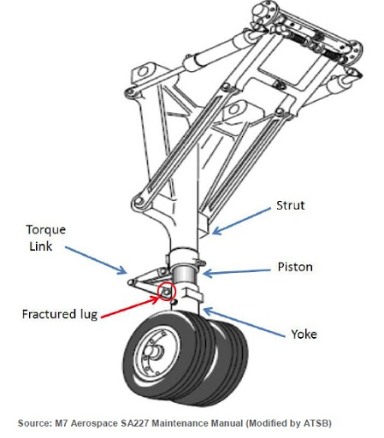
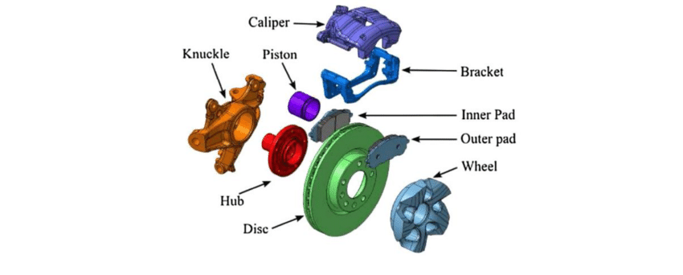
Course Assessment
100% Coursework
A report detailing the suitable processes for manufacture of:
An aerospace assembly
A common engineered product

Slide 21
Introduction to Manufacturing
Primary Manufacturing – Conversion of ores and minerals to raw material
Secondary Manufacturing – Transformation of raw material into shapes

Slide 22
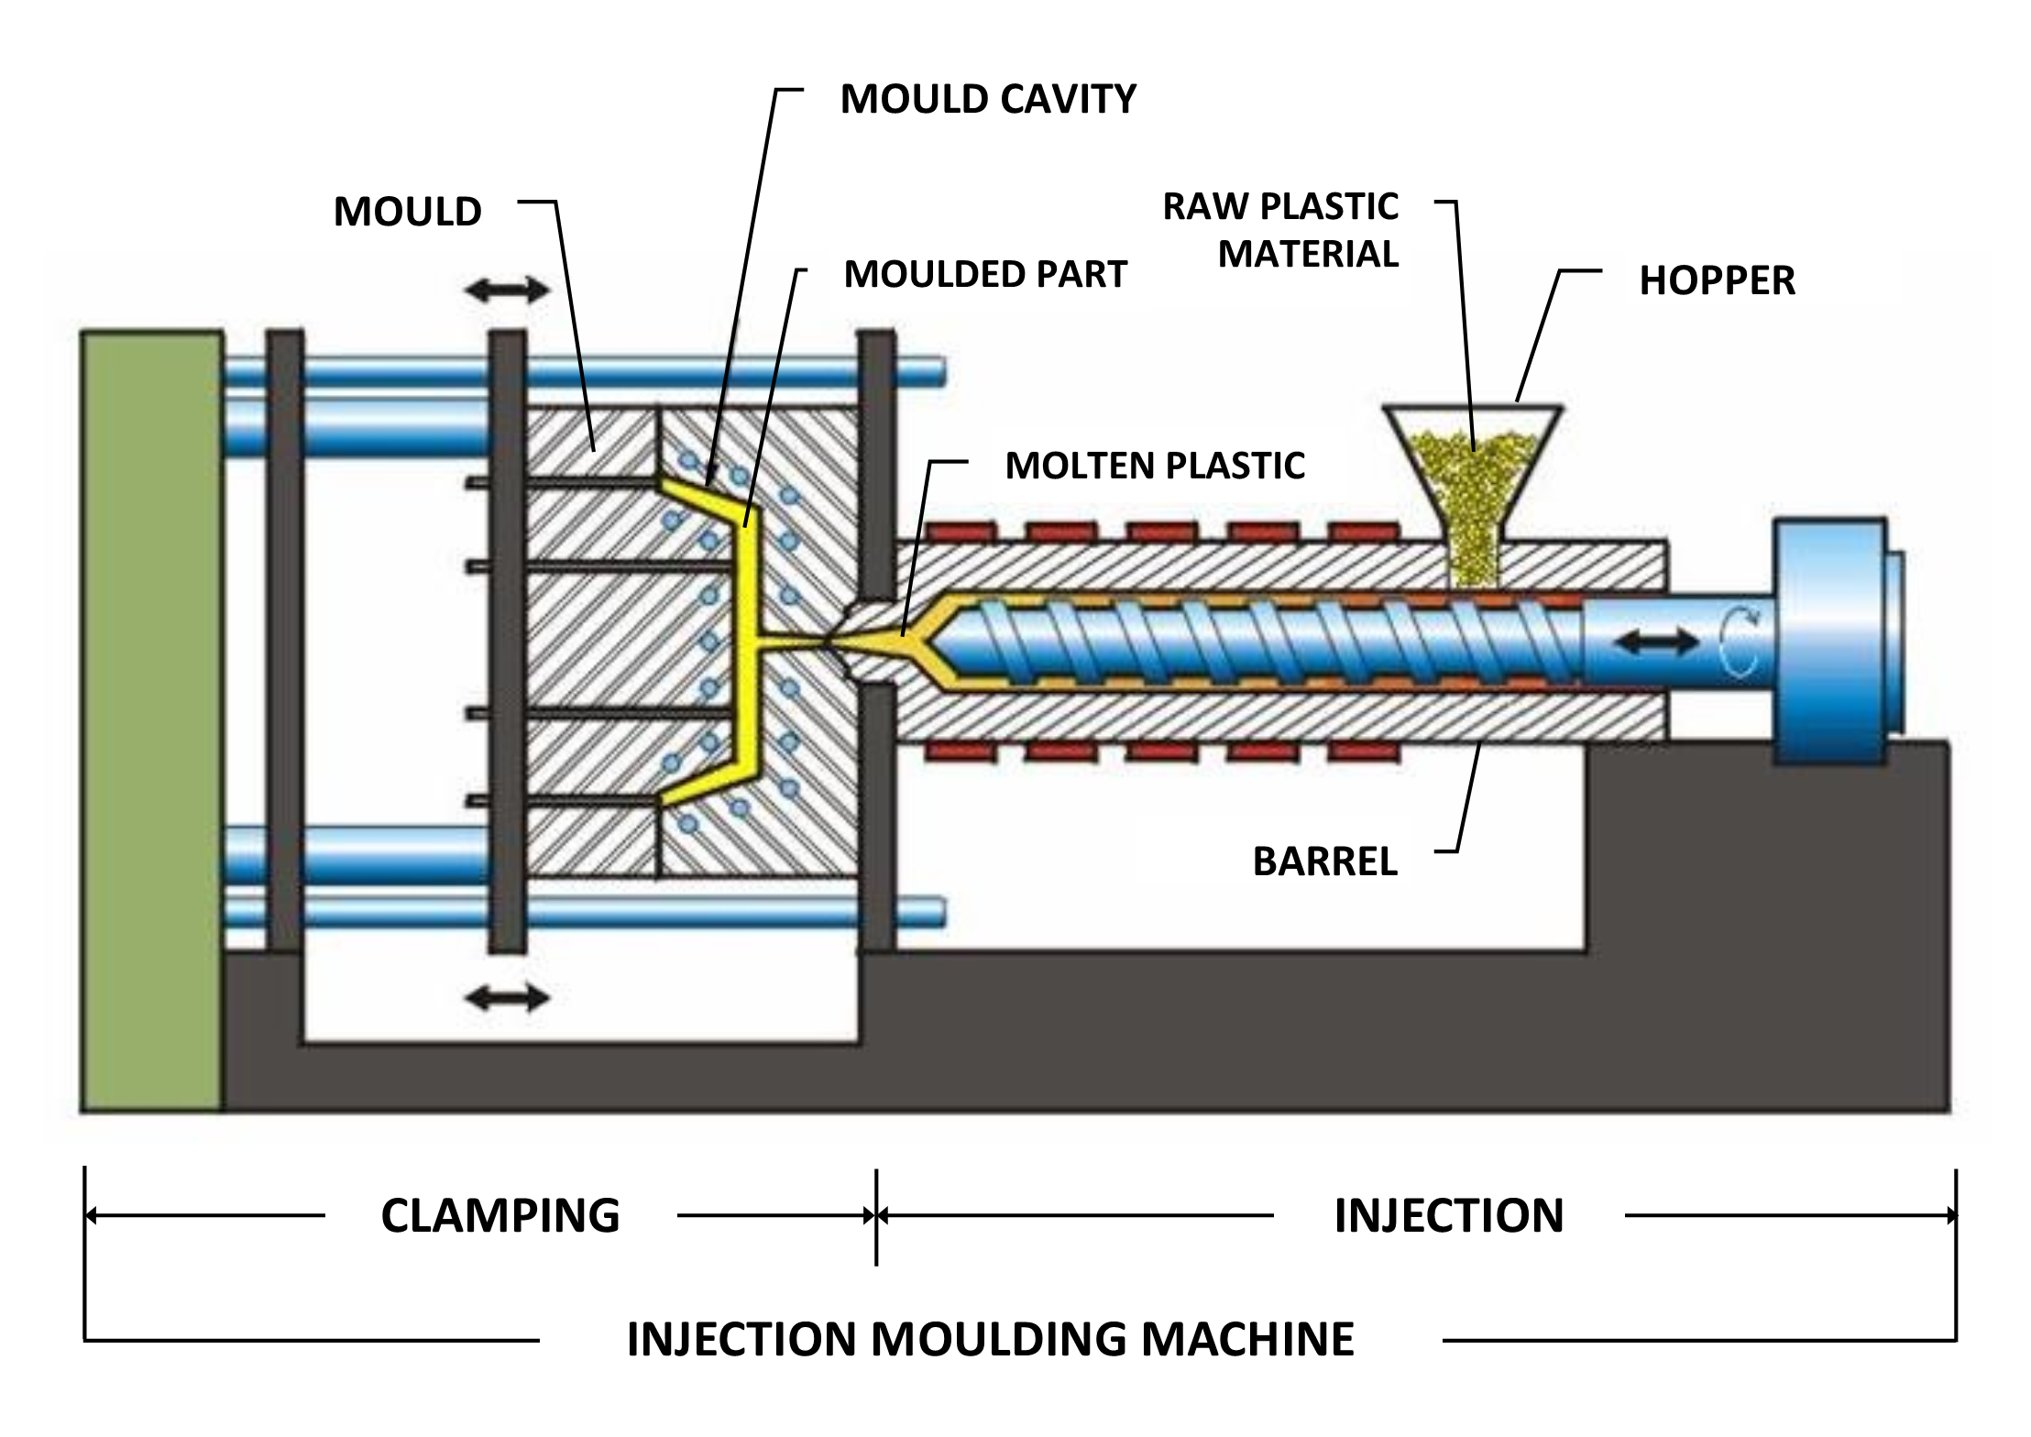
Secondary Manufacturing
Joining
Secondary shaping
Welding
Machining
Surface Treating
Secondary moulding/casting
spraying

Slide 23
Classification of Mfg Processes
Subtractive –
Material removed from a solid block until the desired shape is achieved (Milling, Turning, Grinding, Drilling)
Formative –
Mechanical forces applied to material to form it into the desired shape (bending, forming, moulding)
Additive –
Material manipulated so that successive pieces of it combine to gradually grow the part (welding, cladding, surface treatment)

Slide 24
The role of materials
There is an relationship between material selection and manufacturing process
Only in the last 150 years have significant advances been made in development and utilisation of new materials.
The drive to improve strength to weight ratio of aircraft structures has spurred on R&D into the development of lighter and stronger materials
Choice of materials and manufacturing methods in the development of a product often dictates its success or failure in an engineering/commercial context.

Slide 25
What we’re going to cover over the next few weeks…
Non Traditional Processes
EDM, ECM
Waterjet, Ultrasonic
Additive Manufacture
Composite Materials
Composites
Materials Overview
Lay-Up
Pultrusion
Resin Transfer Moulding
Ceramics
TBC’s
Spray Processes
Metals
Casting
Bulk Deformation
Sheet Deformation
Machining
Welding
Oxyfuel
Mig / Tig
Manual Metal Arc / Shielded Metal Arc
Polymers
Injection Moulding
Blow Moulding
Others

Slide 26
Summary
The importance of materials and
process selection
Classification of manufacturing processes
Brief introduction to materials used in aerospace

Slide 27

Where is this?

Slide 28


Slide 29
Quiz!
What factors affect choice of manufacturing process?
Material
Cost
Speed
Tolerance
Surface finish
Size

Slide 30
Casting

Slide 31
Casting
The most basic method of metal shaping
The process involves:
Pouring molten metal into a formed mould
Allowing it to cool
Removing the metal from the mould

Slide 32
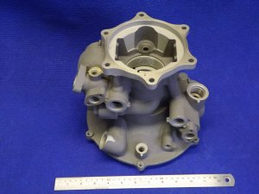
Aerospace Castings
Gearbox housings
Power transmission housings
Complex geometries
Pumps
Fan cases
Turbine blades
Landing gear

Slide 33
Casting
Important considerations are:
Flow of molten metal into the cavity
Solidification and cooling of the metal in the mould
The influence of the type of mould material

Slide 34
Casting of pure metals
Pure metals have clearly defined melting and freezing points
As metal is poured into the mould
Melt cools until it drops below freezing point
Temperature remains constant while latent heat of fusion given off – solidification
Solidification front moves through molten metal from walls to centre
Once solidification takes place, cooling resumes
Solidified metal (casting) is taken out of the mould

Slide 35
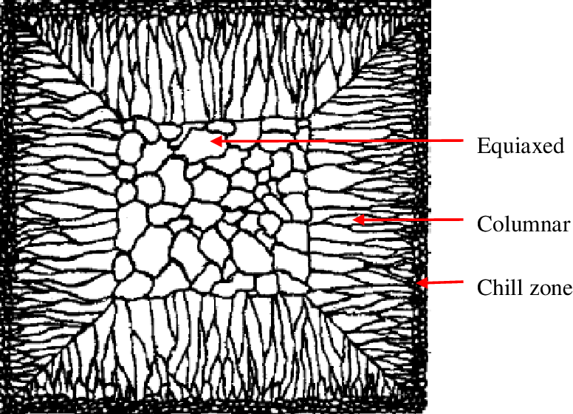
Cast structures
At mould walls (Tambient) metal cools rapidly
This produces a skin of fine equiaxed grains
The grains grow in a direction opposite to the heat transfer out through the mould
Grains with favourable orientation grow preferentially
These are called Columnar grains

Slide 36
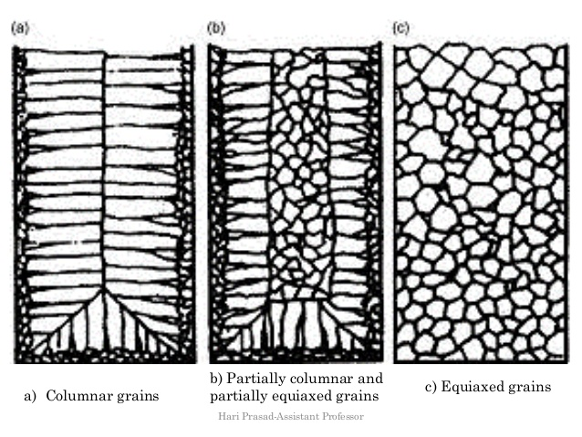
Cast structures
Driving force of heat transfer is reduced away from the walls
The grains in the centre become equiaxed and course

Slide 37
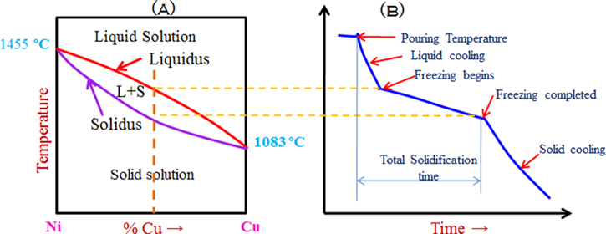
Solidification of alloys
Solidification begins when temps drop below liquidus
Complete when it reaches the solidus
Within this temperature range, metal is in a mushy state

Slide 38
Solidification of alloys
Mushy state contains ‘Dendrites’
Dendrites form because of changes in alloy concentration at solidification front –differential solidification rates
In between solid dendrites, the metal is still liquid
Cooling rate and thermal gradient will influence type of dendrite formation

Slide 39

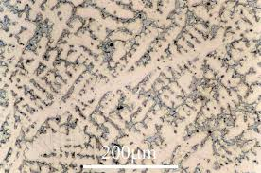
Dendrites
Ice dendrites
Copper – Tin dendrites

Slide 40
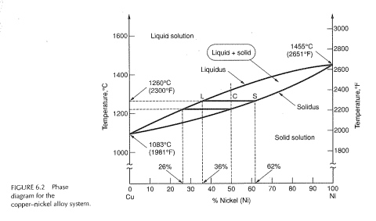
Composition change during solidification
Dendrite formation contributes to factors such as :
Micro – segregation
Micro- Porosity

Slide 41
Defects
Several defects can occur in castings
Severn standard categories of defects are identified:
Metallic projections – flashing, swelling, rough surface
Cavities – blowholes, porosity
Discontinuities – cold/hot tearing, cold shutting
Defective surface – scars, blisters, scabs
Incomplete castings – misruns, insufficient volume of melt…
Incorrect dimensions or shape – pattern misalignment, shrinkage, warping
Inclusions – stress raising particles from O2 reactions, foreign materials

Slide 42
Defects

Slide 43
Phase change & Shrinkage
Shrinkage causes dimensional changes and sometimes cracking. It is the result of the following:
Contraction of molten metal as it cools prior to solidification.
Contraction of metal during phase change
Contraction of solidified material (largest effect)

Slide 44
Major casting Processes
Ingot casting
Continuous casting
Shape casting
Expendable mould
Permanent mould

Slide 45
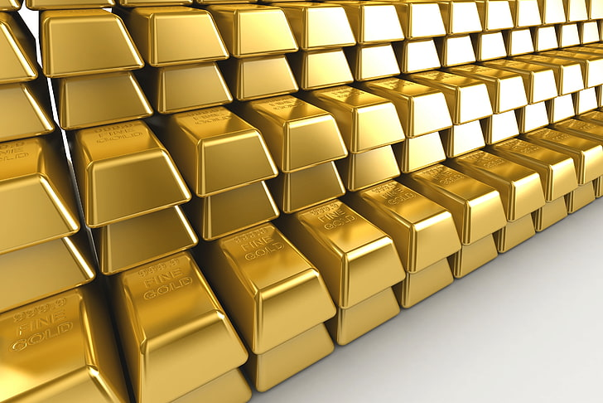
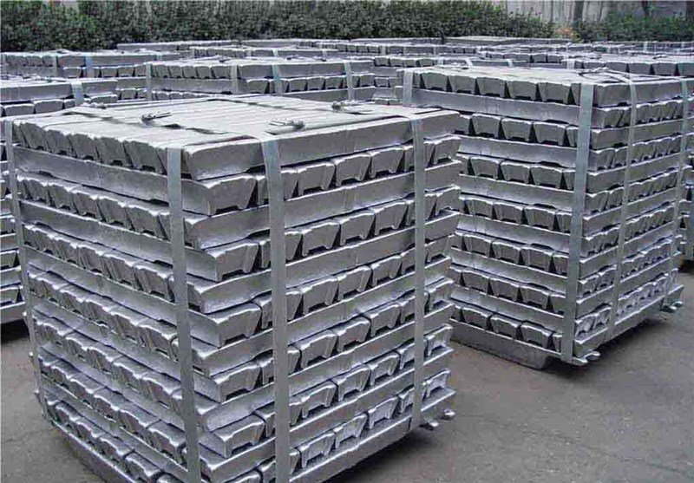
Ingot Casting
Simple cross sections
10’s to 1000’s Kg
Straightforward process
Control of imperfections and porosity required
Slow batch process
Ingots cut to size for further processing

Slide 46
Continuous Casting
Continuous casting developed to reduce cost associated with ingot post processing
Smaller cross sectional shapes ( bar, slab, rod) can be produced directly from the melt
Still very large scale operation

Slide 47
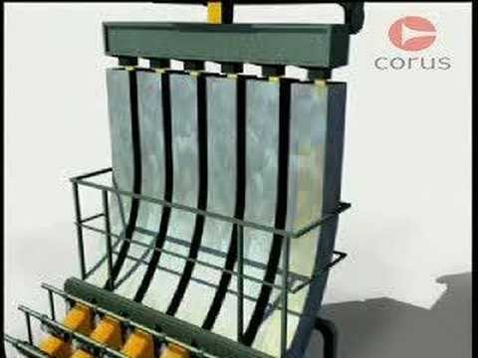
Continuous Casting

Slide 48
Shape Casting
Shape casting differs from ingot/continuous casting as components produced do not require further bulk deformation or machining processes to complete the desired shape
Shape casting is often the method of choice for producing large and small complex items:
Engine blocks
Turbine blades

Slide 49
Stages of shape casting
Molten metal is poured into a mould of the shape of part required
Most shape cast parts require subsequent finishing:
Removal of feeding system
Surface cleaning and finishing
Shape casting generally requires a feed system

Slide 50
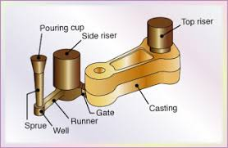

Slide 51
Types of shape casting
Expendable / Non – Permanent Moulds
Sand casting
Investment Casting
Shell Moulding
Plaster/Ceramic Mould Casting
Permanent Moulds
Die Casting
Centrifugal Casting

Slide 52
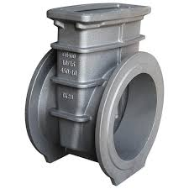
Sand Casting
Most basic and widely used method of shape casting
Sand is used as the mould material (though not beach sand)
The shape to be cast is typically made of wood

Slide 53
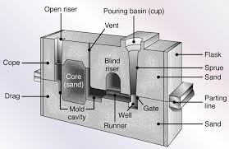
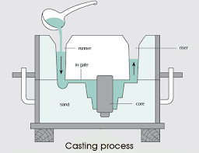
Sand Casting Mould Features
Vents are placed in moulds to carry off gases introduced when the molten metal comes into contact with the sand.
They also exhaust air from the mould cavity as the molten metal flows into the mould.

Slide 54
Sand Casting: step 1
First make the pattern
Wood, metal, plastic…
Tapered sides or draft angle (5º) enable easy withdrawal from the mould
Pattern size should take account of shrinkage -

Slide 55
Sand Casting step 2
Now make the FLASK(mould) in which the pattern will be placed
Bottom is called the DRAG
Top is called the COPE
Pins ensure good alignment
Bolts prevent the two halves from splitting under pressure from the melt

Slide 56
Sand Casting step 3
Place the pattern in the Drag –bottom half
A parting compound such as talc is used to facilitate removal of the pattern from the mould

Slide 57
Sand Casting step 4
Sand must be moist to provide good cohesion –not too moist to cause excessive steam
Usually a mixture of sand, clay and water
Fine sand provides good surface finish and fidelity on fine detail
Needs to provide sufficient permeability to allow gasses to escape

Slide 58
Sand Casting step 5
The sand is gently sieved over the pattern and then gradually more sand is added and the sand is rammed to increase packing density
The sand is levelled off.
The box is turned over and the pattern is carefully removed

Slide 59
Sand Casting step 6
A pouring cup and runners will be added to the cope (top half)
Cope and drag assembled
Pour metal into top of mould
Continue feeding until molten metal comes out of riser

Slide 60
Sand Casting step 7
The melt is allowed to cool
The two halves of the flask are separated
The part is removed

Slide 61
Sand Casting step 8
The component is cleaned up
Failure –insufficient metal
Success –the pouring cup and runner will now be removed

Slide 62
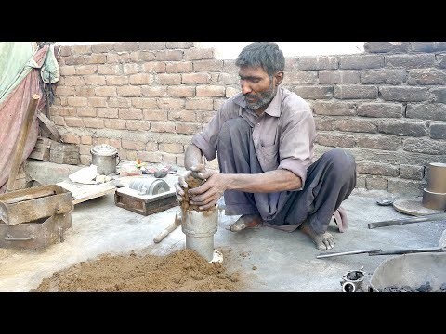

Slide 63
Summary
What we have learned today...
Casting fundamentals
Solidification structures
Defects
Mould features
Ingot Casting
Continuous Casting
Shape Moulding
Sand casting

Slide 64
Homework
Look out for ice dendrites on frosty car windows.

Slide 65
That’s all folks
See you next week!

